Slide 1
LinkedIn Freshers
Developing the product
Product Owner: Debdeep Bandyopadhyay
© 2019 Udacity. All rights reserved.

Slide 2
Getting Started

Slide 3
Create Project Blueprint
A product launch is not just about deploying a beautifully designed,built and thoroughly tested feature. Your company needs to be equally prepared if not more to support every possible customer interaction associated with the product (e.g landing on your company website to learn more about the new feature)
© 2019 Udacity. All rights reserved.
Notes:
[ALL PARTICIPATION]

Slide 4
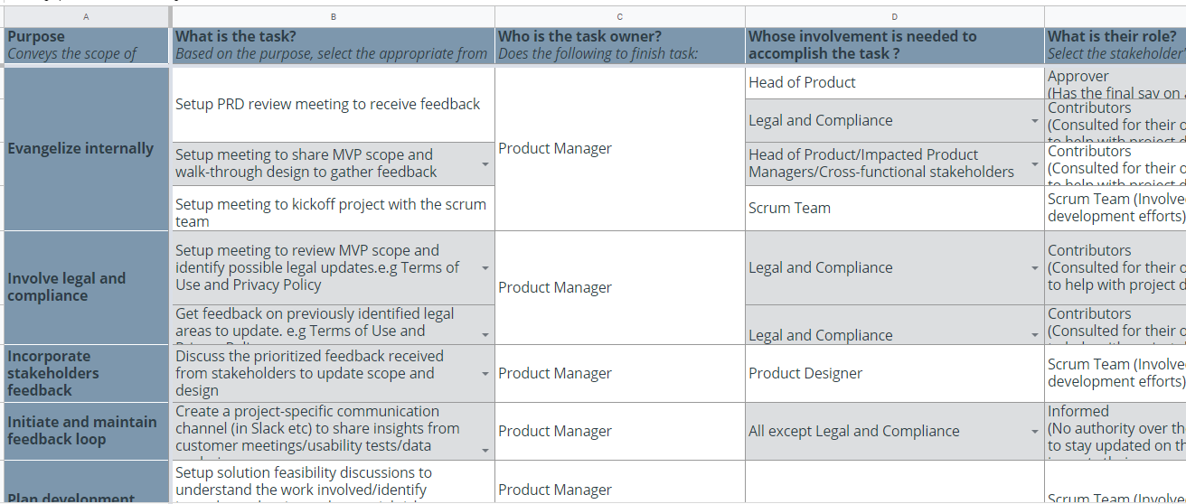
Create a coordination activities map
Share your project-specific coordination activities map here (Insert Link here). You can also share a screenshot below.
© 2019 Udacity. All rights reserved.

Slide 5
Plan for Sprint Meeting
As a PM, it is important to stay ahead of your scrum team and be prepared for every upcoming sprint by having a target goal defined with prioritized backlog for team to start costing and breaking down the tasks
© 2019 Udacity. All rights reserved.
Notes:
[ALL PARTICIPATION]

Slide 6
Sprint Planning Meeting Preparation
Sprint Goal
Enable new graduates to access practise module of LinkedIn to help them prepare for interviews, mock assessments and provide them with feedbacks.
Sprint Backlog (list the prioritized user-stories from the product backlog)
1 | As a new graduate, i want to practise interviews to raise my confidence.
2 | As a new graduate i want to receive feedbacks to find out my strength and weakness
3 | As a new graduate i want to know the type of questions asked in interview beforehand
4 | As a linkedIn user, i want to experience the AI based interviewer and provide feedback
5 | As a linkedin user, i want to recommend the product in my university
Sprint Prioritization Logic
Having a fully functional deliverable at the end of the sprint where full interview prep module can be accessed. Prioritizing riskier work such as AI model training, data storage and pipelines and API integration
© 2019 Udacity. All rights reserved.

Slide 7
User Story 1
User Story | As a new graduate, i want to practise mock interview to boost my confidence for upcoming interviews
Design | Slide #8
Acceptance Criteria | A logged in user should be able to find the feature at the bottom navigation bar. A user should be able to find some recommended topic on the interview practise page based on their interests, goals and search pattern. A user should be able to gain feedback from his interview and recommended courses , mentors and suggestions. The page should be mobile responsive. User should be able to look into his historical interview results and feedback. The product should be aligned with GDPR protocols
Assumptions | User should have an account on our platform. Interviews will happen in english only.
© 2019 Udacity. All rights reserved.

Slide 8
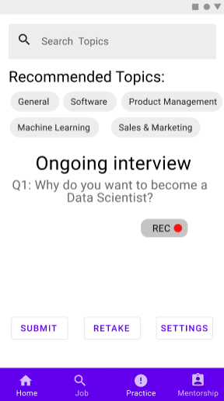
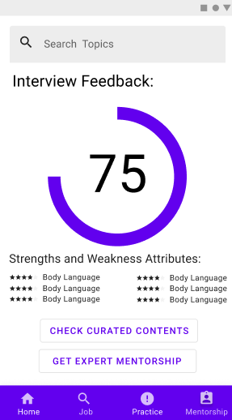
Prototype screenshot 1

Slide 9
User Story 2
User Story | As a new graduate , I want to seek help from mentors for achieving my career goals.
Design | Slide #10
Acceptance Criteria | A logged in user should be able to find the feature at the bottom navigation bar. A user should be able to find some recommended mentors based on their interests, goals and search pattern. A user should be able to approach the mentor and chat with him. A user should also be able to chat with him over video. The page should be mobile responsive. The product should be aligned with GDPR protocols
Assumptions | User should have an account on our platform. Interviews will happen in english only.
© 2019 Udacity. All rights reserved.

Slide 10
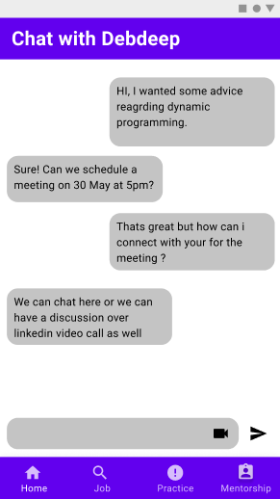
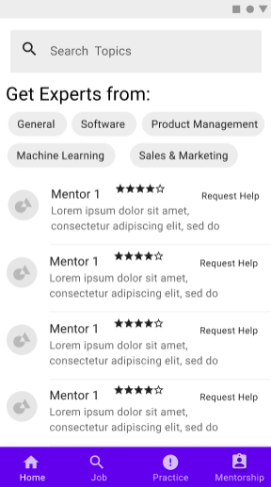
Prototype screenshot 2

Slide 11
Decoding API Documentation
As a PM, you will collaborate with the engineering team and provide guidance that heavily influences their development approach. When a product requires an API integration, sometimes PM need to be “technical enough” to understand the following to refine the solution with designer and development team
what information is available via the API
how is it available
possible pricing impact
© 2019 Udacity. All rights reserved.
Notes:
[ALL PARTICIPATION]

Slide 12
LinkedIn Project
Based on the API documentation how would you update your solution and design? | We would be using Jobs Lookup API to recommend jobs and company specific interview resources based on the job title attributes. We would be using TF-IDF word2vec model for recommending mentors whose profile aligns with user’s goal and needs.
Based on your high-level understanding of the API documentation, are there any details that you want to discuss with engineering to refine solution and/or determine feasibility | What are the other APIs that would prove efficient in recommendation and their license and cost implications ? What are the existing recommendation engine that can be extended into our features ?

Slide 13
Re-prioritize Sprint Backlog
As a PM, unexpected issues and new feature requests will require you to triage them efficiently and re-prioritize the sprint backlog without impacting the roadmap deliverables significantly
© 2019 Udacity. All rights reserved.
Notes:
[ALL PARTICIPATION]

Slide 14
Issue 1: Landing Page loading too slow
Determine impact and criticality to prioritize issue | Since the customer team has filed a ticket as ‘bug’ [Priority = 1] stating that users are complaining that the landing page upon logging is too slow to load and the same has been assured by Q/A team , the issue should be prioritized as CRITICAL.and needs to be fixed immediately as it affects one of our metrics heavily and it also leads to our reputational risk. It is important to collaborate with the stakeholders to find if the bug has a high frequency of occurrence and impacts a lot of users.
Next Steps You would carry out typically using JIRA (ticketing tool), communication channel (Slack) | Update issue priority to CRITICAL Keep stakeholders in loop to inform them of priority upgradation in issue mid-sprint Ensure issue is fixed by allocating it in the high priority depending on existing priority of other bugs.
Would you take additional steps ? | Set up meeting with the development team to document the reasons for bug’s existence. Schedule hotfix roll out and communicate with end user regarding the fix, while keeping customer service and QA teams in loop to ensure application is restored to work optimally.
© 2019 Udacity. All rights reserved.

Slide 15
Issue 2: Misaligned fields in Profile Settings
Determine impact and criticality to prioritize issue | There is no mismatch in user expectations as users in general are used to normal forms adhering to design standards across apps/previous versions. So, this step can be skipped and one can work with QA to see reproducibility in other platforms outside Android Collaborate with stakeholders to understand reputational risk, frequency and user impact of the issue at hand to assign priority The issue can be prioritized to NORMAL, as it doesn’t directly affect any of our metrics and neither the core business value provided by our app. The impacted users are also limited to a small number of users visiting the update profile page (2% of Android users ~ 0.5%).
Next Steps use ticketing tool (JIRA), and communication channel (Slack) | Update issue priority to NORMAL Keep stakeholders in loop to inform them of priority upgradation in issue mid-sprint Ensure issue is fixed by aligning with customers expectation and depending on existing priority of other bugs, deploy it in next release cycle.
© 2019 Udacity. All rights reserved.

Slide 16
Respond to Customer Service Manager’s Email
Determine impact and criticality to prioritize the issue (1 - Critical; 2 - High; 3 - Normal; 4 - Low) | Collaborating with QA team to understand why the email is delivered late although the reset link is same. Once QA team updates regarding the cause, collaborate with stakeholders to understand what is causing this delay. The assigned priority will be HIGH as it impacts only our internal tool users who have forgotten password, which as per data constitutes 7% of the users.
Next Steps You would carry out typically using JIRA (ticketing tool), communication channel (Slack) | Update issue priority to HIGH Keep stakeholders in loop to inform them of priority upgradation in issue mid-sprint Ensure issue is fixed by allocating it in the customer delights/stakeholder requests buffer depending on existing priority of other bugs to deploy as hotfix.
Sample Email Response | Hi <Customer_Service_Mananger_Name>, After reviewing your issue with internal stakeholders, we have assigned a priority HIGH. Our scrum team are looking into fixing the issue by the next sprint and deploy it as a hotfix. Till then, I would request your team to handle internal users via some alternative methods like internal communication channels. Our scrum team will assist you in sending the reset links. Thank you for your patience and have a nice day!
© 2019 Udacity. All rights reserved.

Slide 17
Handle Potentially Difficult Situations
As a PM, you will be faced with many unexpected situations where you have to make a decision or push back while managing competing priorities from stakeholders and tackling issues that could potentially affect your product launch
© 2019 Udacity. All rights reserved.
Notes:
[ALL PARTICIPATION]

Slide 18
Respond to CEO or GM’s request via email
Assessment and result | Communicate and listen to the CEO/GM to understand the exact features he is intending to showcase, the stakeholders involved and whether his timeline/needs are flexible (i.e. whether it is possible to present after sprint end, whether a video demo is fine) Inform the CEO/GM the current state of the product as untested, unstable, semi-functional code with evolving QA environment which would be available by the sprint end, and accordingly come up with a viable solution based on company guiding principles Based on above inputs, set a meeting with scrum team to update priorities to issues mid-sprint, allocate tasks to stakeholder requests buffer and deploy a demo on time/set a meeting with other stakeholders to deploy an alternative to the demo/negotiate to delay demo till completion
Sample Email Response | Hi <CEO/GM_name>, Based on our previous conversation, I had a meeting with my scrum team to understand feature scope and gathered all the requirements for the demo. Accordingly, we have set up testing and a stable QA environment for the mock interview feature set. I would however point it out to you that some features like audio and chatbot based interview is still an ongoing backlog whose stability is being tested and I would advise you to stick to the prescribed instructions and credentials provided by the QA team for demonstration with stakeholders. Thank you and have a nice day.
© 2019 Udacity. All rights reserved.

Slide 19
Step-in and guide the scrum team at stand up
Video Response | Share the link to your video here <insert link>
© 2019 Udacity. All rights reserved.

Slide 20
Handling Resource Constraints
List 2- 3 activities that you would carry out as a PM to unblock the scrum team immediately ? | Communicate with other stakeholders,product managers,head of product and head of QA about the problem and asking for extra resource. If no extra resource is available, delegate the responsibility to any existing member within the team. If the deployment is not immediate, then scrum team can be unblocked by allocating issues related to technical debt/stakeholder requests/emerging bugs during this time.
Since the QA team member is shared across multiple projects, how would you coordinate with other PMs to de-risk your project and raise appropriate visibility ? | Setup a meeting with impacted PMs/Head of Product to understand project scope and deployment schedules, ensuring everyone is aligned with common goals. Depending on above information and company guiding principles, list solutions to unblock projects and achieve specific goals depending on priority. Evaluate the solutions against the common guiding principles to come up with an agreed upon solution Communicate the solution with scrum team to request/allocate/unblock scrum team members and restructure sprint backlog accordingly

Slide 21
Handling Resource Constraints (contd.)
Since there is a potential risk, it is important to raise visibility amongst appropriate stakeholders | Head of Product, Scrum team, impacted PMs, Head of QA and other cross-functional stakeholders
 | If the negotiation was successful, the QA member would be assigned the remaining backlog while mobilizing the rest of the scrum team to unblock/resume new issues created by QA member. Also, in case of time deficit, it would be good to setup a meeting with scrum team to re-prioritize testing so that “must-haves” are separated from “nice-to-haves”. If the negotiation was unsuccessful but the deployment is immediate, then one would set up meeting with the scrum team to delegate QA tasks to an internal member and re-prioritize sprint backlog to focus on “”must-haves”. However if the deployment is not immediate, then the scrum team can be unblocked by delegating emerging bugs/stakeholder requests /technical debt issues or even allowing read aheads on new technical tools and topics
© 2019 Udacity. All rights reserved.

Slide 22
How would you handle stakeholder feedback?
Feedback Assessment | What are the exact features and triggers that the stakeholder is talking about ? Are the entire team and cross-functional stakeholders on the same page regarding sprint goals? What is the rationale behind imbibing notification feature at the current stage and how would it would help achieve sprint goals? What are the features that can be introduced later ?
Video Response | Share the link to your video here (insert link)
© 2019 Udacity. All rights reserved.

